Slide 1
DiffusionDepth: Diffusion Denoising Approach for
Monocular Depth Estimation
Yiqun Duan
University of Technology Sydney
Abstract: Monocular depth estimation is a challenging task that predicts the pixel-wise depth from a single 2D image. Cur rent methods typically model this problem as a regression or classification task. We propose DiffusionDepth, a new approach that reformulates monocular depth estimation as a denoising diffusion process. It learns an iterative denoising process to ‘denoise’ random depth distribution into a depth map with the guidance of monocular visual conditions.
PubDate：29 Aug 2023 Subject: Computer Vision and Pattern Recognition(CVPR 2024)
Notes:
扩散模型又是概率论ψ(._. )>

Slide 2

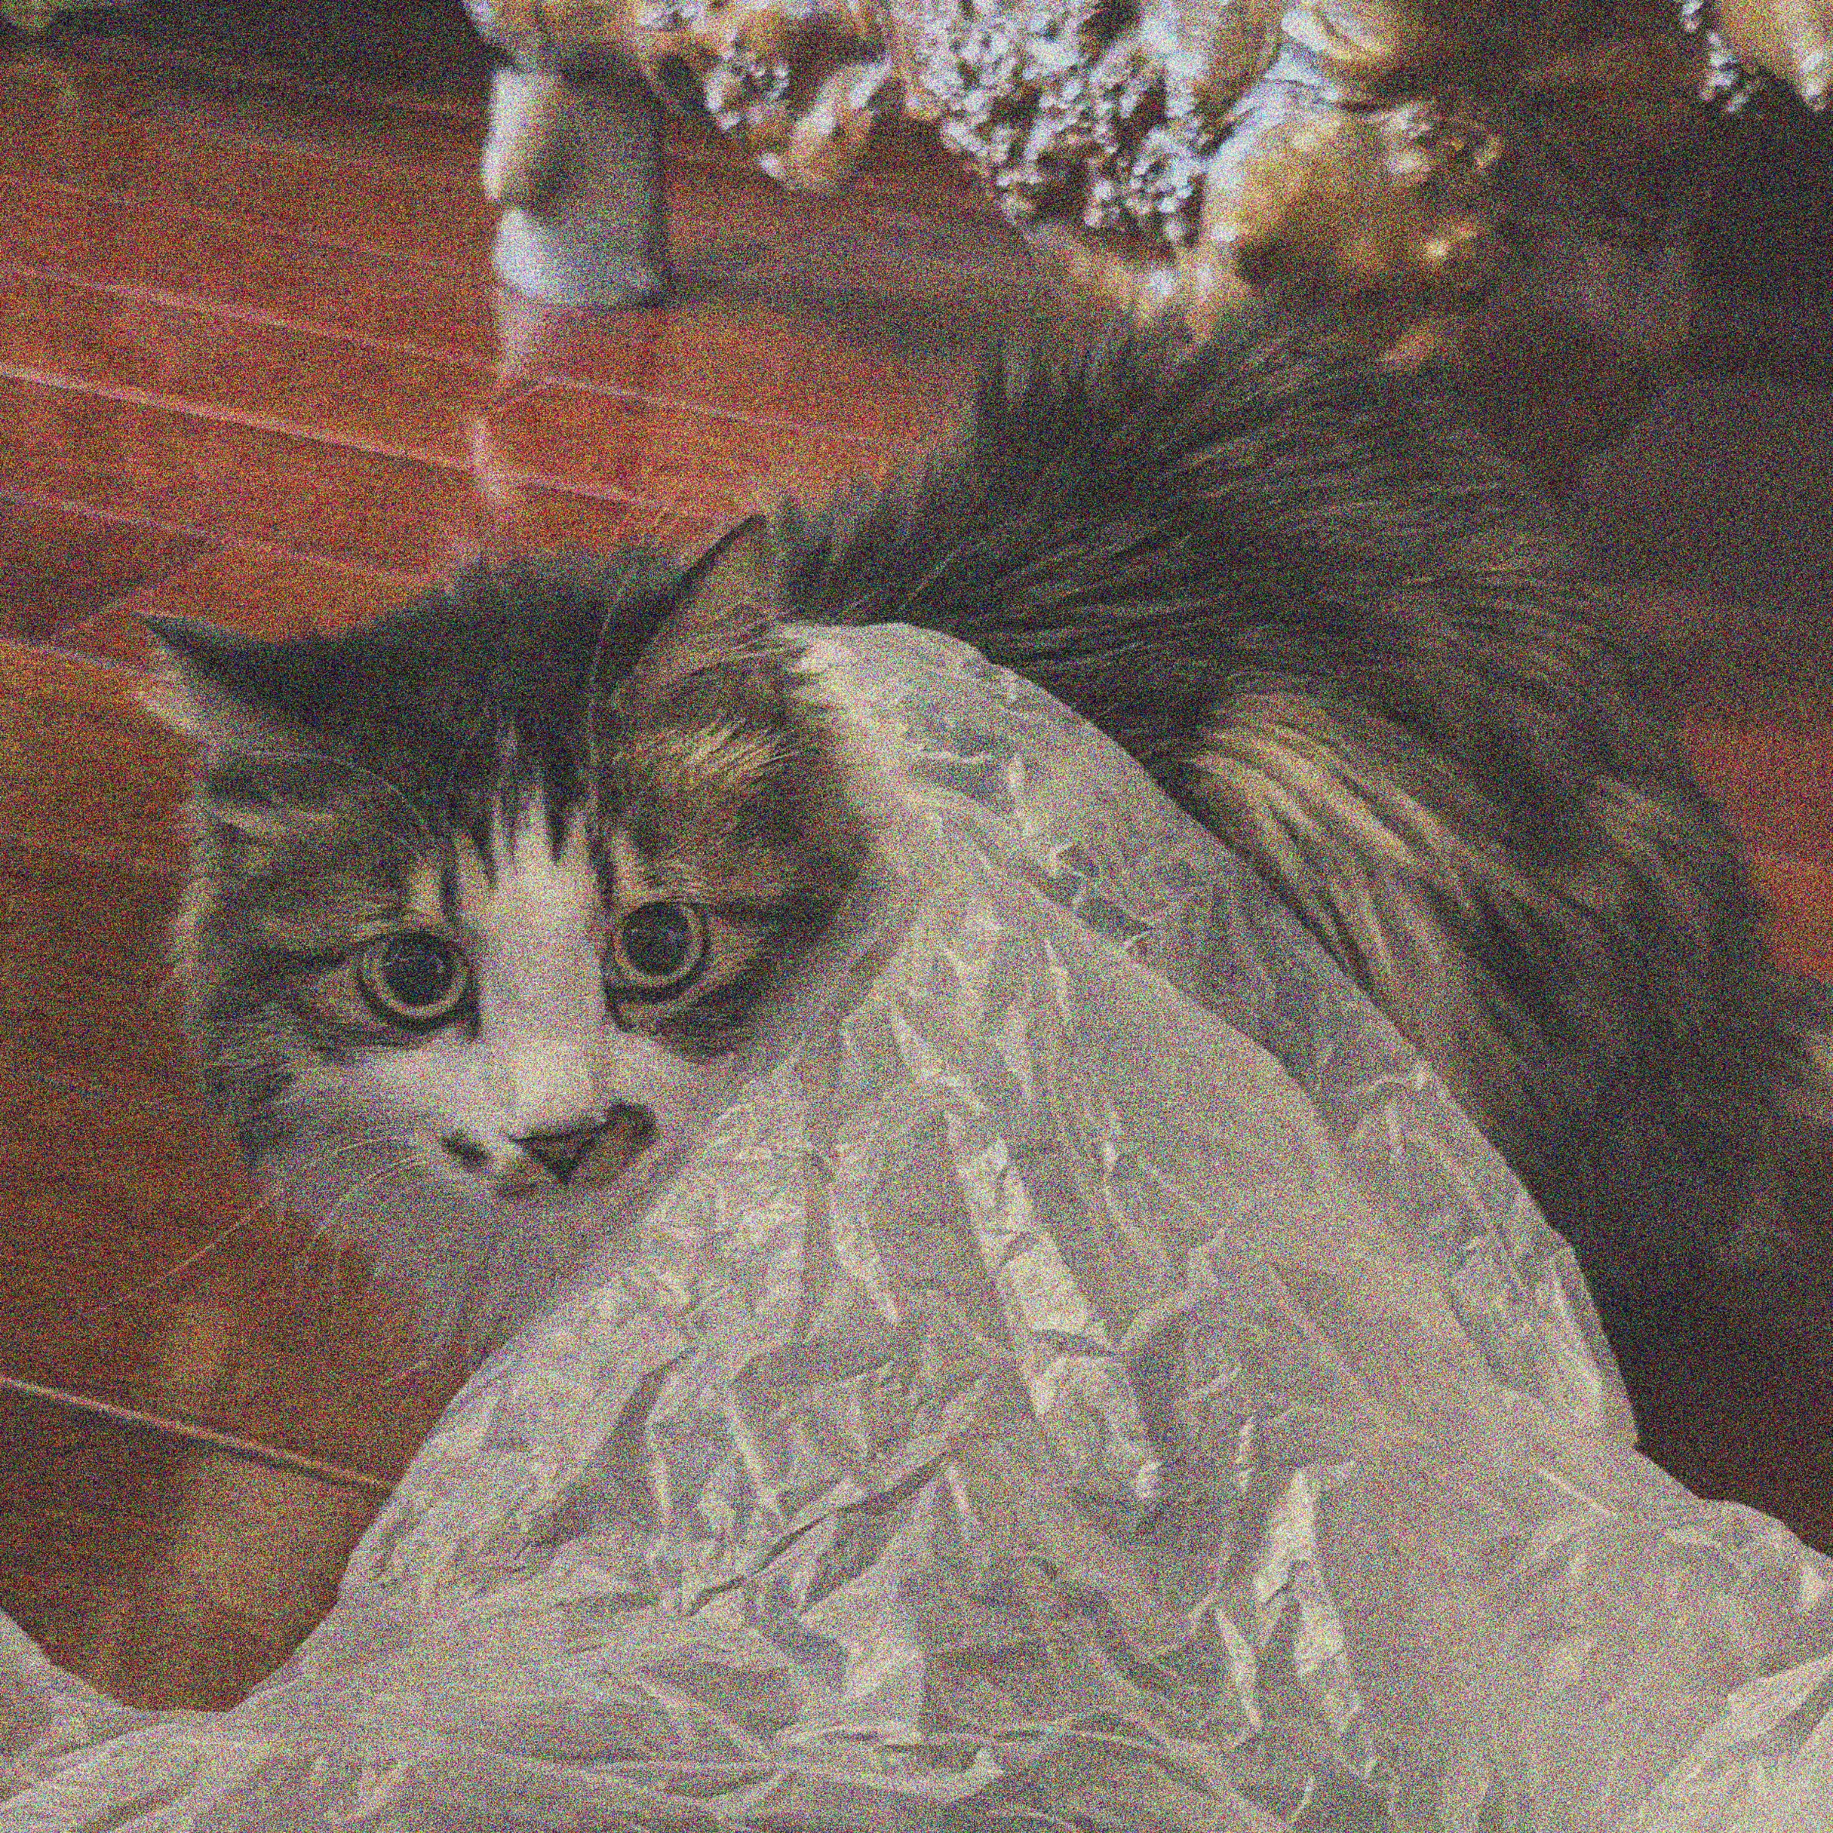
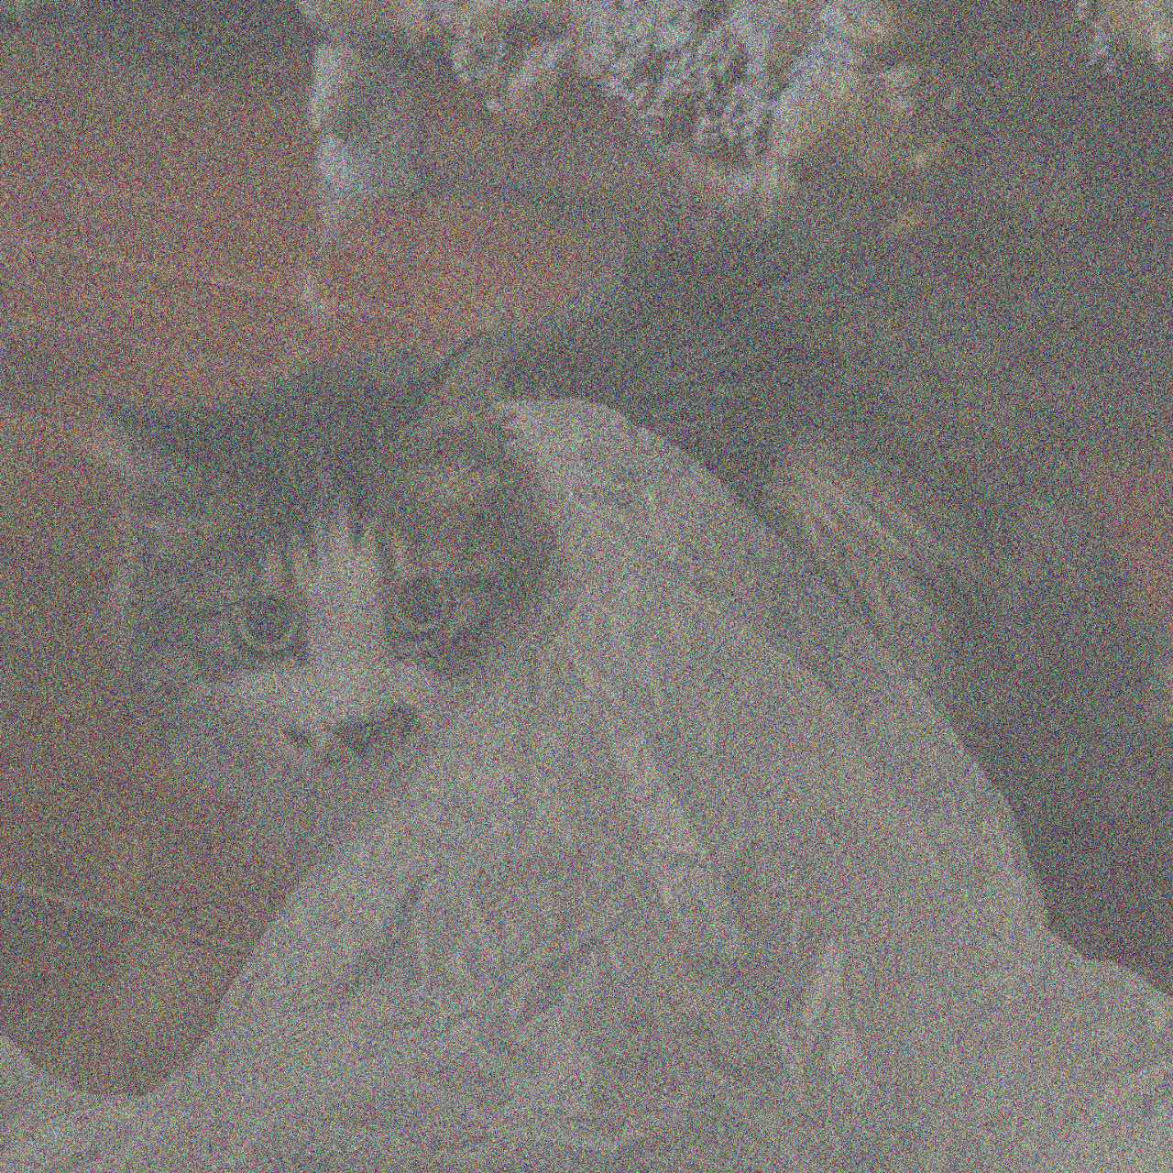

What is Diffusion Model ?
Denoising Diffusion Probabilistic Models ^{[1]}
^{[2]}
Forward Diffusion Process
Data
Noise
Reverse Diffusion Process
Data
Noise
[1] Ho J, Jain A, Abbeel P. Denoising diffusion probabilistic models. NeuraIPS, 2020.
[2] Small MI. Jingxuan Wang, 2020

Slide 5
The end
Reference:
Ho J, Jain A, Abbeel P. Denoising diffusion probabilistic models. NeuraIPS, 2020.
Duan Y, Guo X, Zhu Z. Diffusiondepth: Diffusion denoising approach for monocular depth estimation[C]//European Conference on Computer Vision, 2024
Liu, Ze, et al. "Swin transformer: Hierarchical vision transformer using shifted windows." Proceedings of the IEEE/CVF international conference on computer vision. 2021.
Song J, Meng C, Ermon S. Denoising diffusion implicit models[J]. arXiv preprint arXiv:2010.02502, 2020.
“
The sculpture is already complete within the marble block before I start my work. It’s already there, I just have to chisel away the superfluous material
”
——Michelangelo

